Slide 1
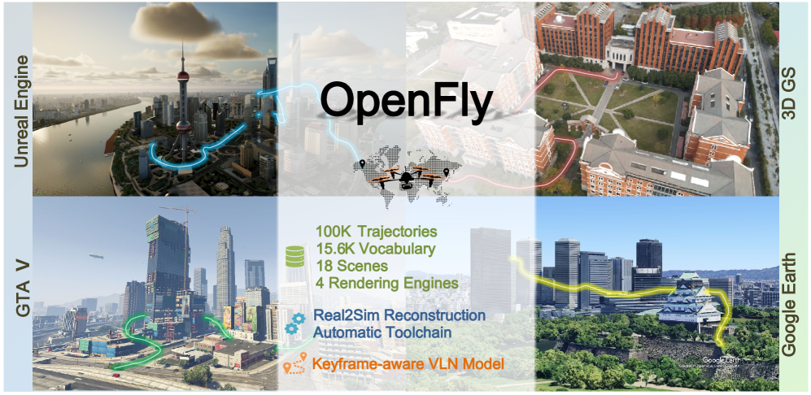
OpenFly: A Comprehensive Platform for Aerial Vision-Language Navigation
Dr. Peng Jiang Lab
Presented by: Dev Patel
Computer Science in Artificial Intelligence
Notes:
Hello Everyone, Good morning. My name is Dev Patel, and I am a second-year graduate student. Today, I will be presenting a research paper on Openfly's comprehensive platform for aerial Vision language navigation.
Before beginning the presentation, I would like to give a brief background about VLN.

Slide 2
Introduction
Vision-Language Navigation (VLN) is a core problem in embodied AI, where an intelligent agent must follow natural language instructions while interpreting its surrounding visual environment.
Prior works have made significant progress in indoor and ground-based VLN tasks, aerial setting using drones remains largely unexplored. This is critical because UAVs have enormous potential applications in areas like rescue operations, aerial mapping, and cargo delivery.
To address these limitations, the authors propose OpenFly, a unified platform that integrates multiple rendering engines, an automated data generation toolchain, and a large-scale benchmark dataset, setting the stage for advancing aerial VLN research.
Notes:
Vision-Language Navigation, or VLN, is about enabling intelligent agents to navigate environments by following natural language instructions and interpreting visual inputs.
While prior works have made significant progress in indoor and ground-based VLN tasks, the aerial setting using drones remains largely unexplored. This is critical because UAVs have enormous potential applications in areas like rescue operations, aerial mapping, and cargo delivery.
However, three challenges have slowed progress: the difficulty of collecting large-scale aerial data, the heavy reliance on manual annotation, and the lack of diverse, realistic environments. To address these limitations, the authors propose OpenFly, a unified platform that integrates multiple rendering engines, an automated data generation toolchain, and a large-scale benchmark dataset, setting the stage for advancing aerial VLN research.
To support this hypothesis author broadly designs objectives which I will be discussing in the next slide.

Slide 3
Objectives
OpenFly Platform: Integration of multiple rendering engines (Unreal Engine, GTA V, Google Earth, 3D Gaussian Splatting).
Automated Toolchain: Streamlined pipeline for point cloud acquisition, semantic segmentation, trajectory generation, and instruction generation.
OpenFly-Agent Model: A keyframe-aware VLN model that emphasizes critical observations and reduces redundancy through visual token merging.
Comprehensive Benchmarking: Extensive experiments comparing recent VLN methods, showing superior performance and strong real-to-sim generalization
Notes:
To support this objective author developed an Automated toolchain for data collection.

Slide 4
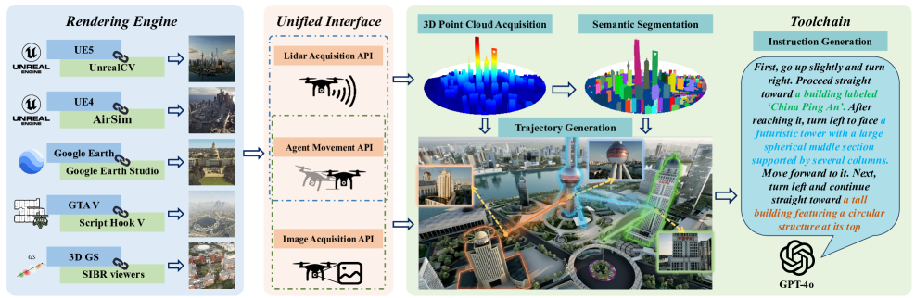
Methodology-Data Collection
Rendering Engines
Unreal Engine (UE4/UE5), GTA V, Google Earth, 3D Gaussian Splatting (3D GS)
Provides diverse, photorealistic aerial environments
Automated Toolchain
Point Cloud Acquisition
Semantic Segmentation
Trajectory Generation
Instruction Generation
Dataset Split
Train: Majority from UE + 3D GS scenes
Test-Seen: Trajectories from previously used scenes
Test-Unseen: New environments (UE-small city, 3DGS-sjtu02, GTA V city)
Notes:
To better understand methodology – data collection Various rendering engines are first integrated, providing diverse high-quality scenes. Built on these, several interfaces and tools are developed,
enabling automated generation of trajectories and instructions.
They used three datasets: split train, test-seen, and test-unseen.
I will be explaining in detail in the upcoming slides.

Slide 5
Rendering Engines
Unreal Engine (UE4/UE5)
Provides high-fidelity synthetic scenes
Rich indoor & outdoor layouts → used for most training data
GTA V
Large-scale open-world cityscapes
Complex urban navigation → ideal for unseen test environments
Google Earth
Real-world geographic imagery
Enables global-scale aerial tasks & realism bridging simulation and reality
3D Gaussian Splatting (3DGS)
Reconstructs real environments from photos/videos
Lightweight & photorealistic → adds real-world diversity beyond game engines
Notes:
Let me start with the Rendering engines, they integrated four rendering engines.
Each rendering engine contributes uniquely. Unreal Engine provides high-fidelity synthetic scenes used mainly for training. GTA V offers a realistic, large-scale open-world city for challenging test environments. Google Earthcontributes real-world imagery, bridging simulation and reality. Finally, 3D Gaussian Splatting reconstructs real environments from photos, adding lightweight yet realistic diversity.

Slide 6
Unified Interface
Agent Movement Interface
CoorTrans module: unifies all engine coordinates to meter-based FLU (Front-Left-Up)
Precise positioning → consistent, automatic trajectory generation across scenes.
Lidar Data Acquisition Interface
Supports multiple LiDAR sources: real sensor, depth back-projection, image feature matching
All LiDAR aligned to the same FLU system via CoorTrans.
Image Acquisition Interface
Unified HTTP RESTful + TCP/IP request layer
Pull images from any pose, with flexible resolution & viewpoint
Notes:
To standardize control across all engines, OpenFly introduces a unified interface. The Agent Movement Interface aligns coordinates into a meter-based FLU system via CoorTrans for consistent trajectories. The Lidar Interface supports multiple sources such as real sensors, depth maps, or image features. The Image Interface uses a RESTful + TCP/IP layer to pull images at any pose or resolution. This unified interface ensures automation across heterogeneous environments.

Slide 7
Automated Toolchain
Point Cloud Acquisition: Rasterized sampling (Unreal Engine, GTA V). Sparse reconstruction via COLMAP (3D Gaussian Splatting)
Scene Semantic Segmentation: Octree-Graph for 3D scene understanding. Point cloud projection + contour extraction (OpenCV).Optional manual annotation for refinement
Automatic Trajectory Generation: Builds global voxel map (Mglobal). Chooses landmarks + start/end points. Uses A* pathfinding for collision-free UAV paths. Supports variable step sizes (3m, 6m, 9m forward moves)
Instruction Generation: Keyframe extraction at action changes. Sub-trajectory segmentation → GPT-4o generates sub-instructions. Sub-instructions fused into full trajectory description. Post-processing with NLTK + embeddings to remove redundancy
Notes:
One of the most innovative parts of OpenFly is its automated toolchain, which replaces the expensive, manual process of piloting drones and writing instructions.
The pipeline starts with point cloud acquisition. Depending on the environment, it either rasterizes sampling points in Unreal Engine and GTA V, or applies COLMAP to reconstruct 3D point clouds in Gaussian Splatting scenes.
Next is semantic segmentation of landmarks. This is crucial because UAVs navigate based on landmarks like towers or buildings. OpenFly provides three strategies: the Octree-Graph method for 3D segmentation, a point-cloud projection plus contour extraction method, or manual annotation if higher precision is needed.
Once landmarks are available, trajectory generation begins. Using the A* pathfinding algorithm on a voxelized global map, the toolchain automatically creates collision-free UAV flight paths with variable step sizes. This allows complex multi-step navigation without human pilots.
Finally, the system handles instruction generation. Instead of sending the full trajectory to a VLM, OpenFly breaks it into sub-trajectories based on key actions. GPT-4o generates sub-instructions, which are then fused into a coherent, natural instruction. A refinement stage with NLTK ensures that instructions are concise and free from redundancy.

Slide 8
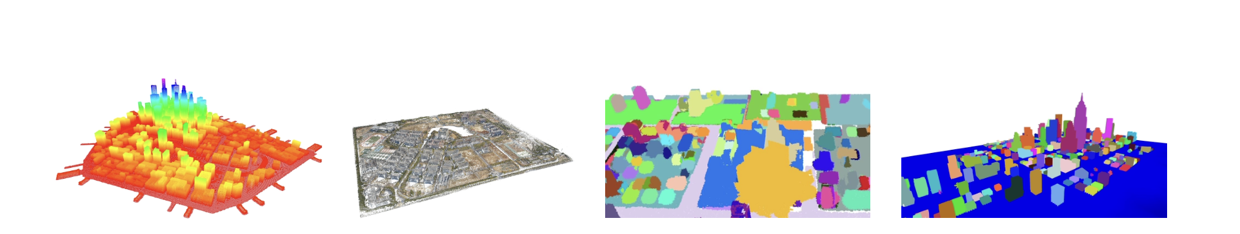
3D GS Data Collection
(a)
(b)
(c)
(d)
(a) Rasterized sampling point cloud reconstruction.
(b) Image-based point cloud reconstruction.
(c) Semantic 3D scene segmentation.
(d) Point cloud projection and contour extraction.
Notes:
Results for point cloud acquisition and semantic segmentation.

Slide 9
Dataset Analysis
Trajectory and Instruction Analysis
Dataset Scale
100K UAV trajectories → largest among VLN datasets
Aerial VLN adds more motion dimensions than ground-based tasks
Trajectory Distribution
Lengths: 0 – 300 meters
Heights: 0 – 150 meters
Action Representation
Discrete actions: {Forward, Turn Left, Turn Right, Ascend, Descend, Stop}
Forward (3m step size) dominates → risk of overfitting
Solution: use 3 granularities of Forward (3m, 6m, 9m)
Also supports continuous waypoint generation
Instruction Analysis
Vocabulary size: 15.6K unique words
Average instruction length: 59 words
Frequent nouns: building, windows, skyscraper
Frequent verbs: proceed, turn
Notes:
The dataset contains 100,000 UAV trajectories, making it the largest in VLN. Trajectory lengths range from 0–300m, and flight heights go up to 150m. Discrete actions such as forward, turns, ascend/descend, and stop are used, with forward dominating. To prevent overfitting, multiple forward step sizes—3m, 6m, and 9m—were added. The language component is equally rich, with a 15.6K vocabulary and average instruction length of 59 words, often referencing landmarks like buildings and windows.

Slide 10
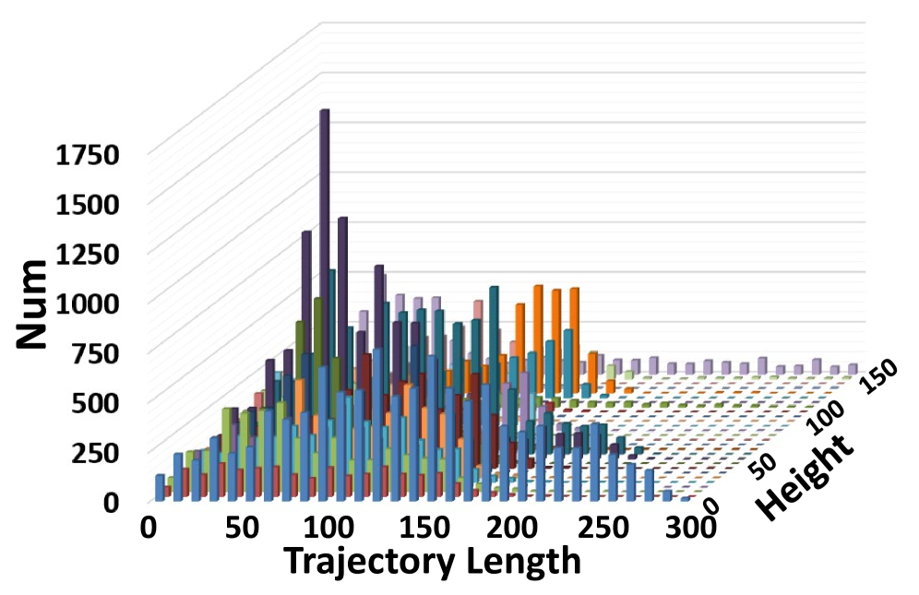
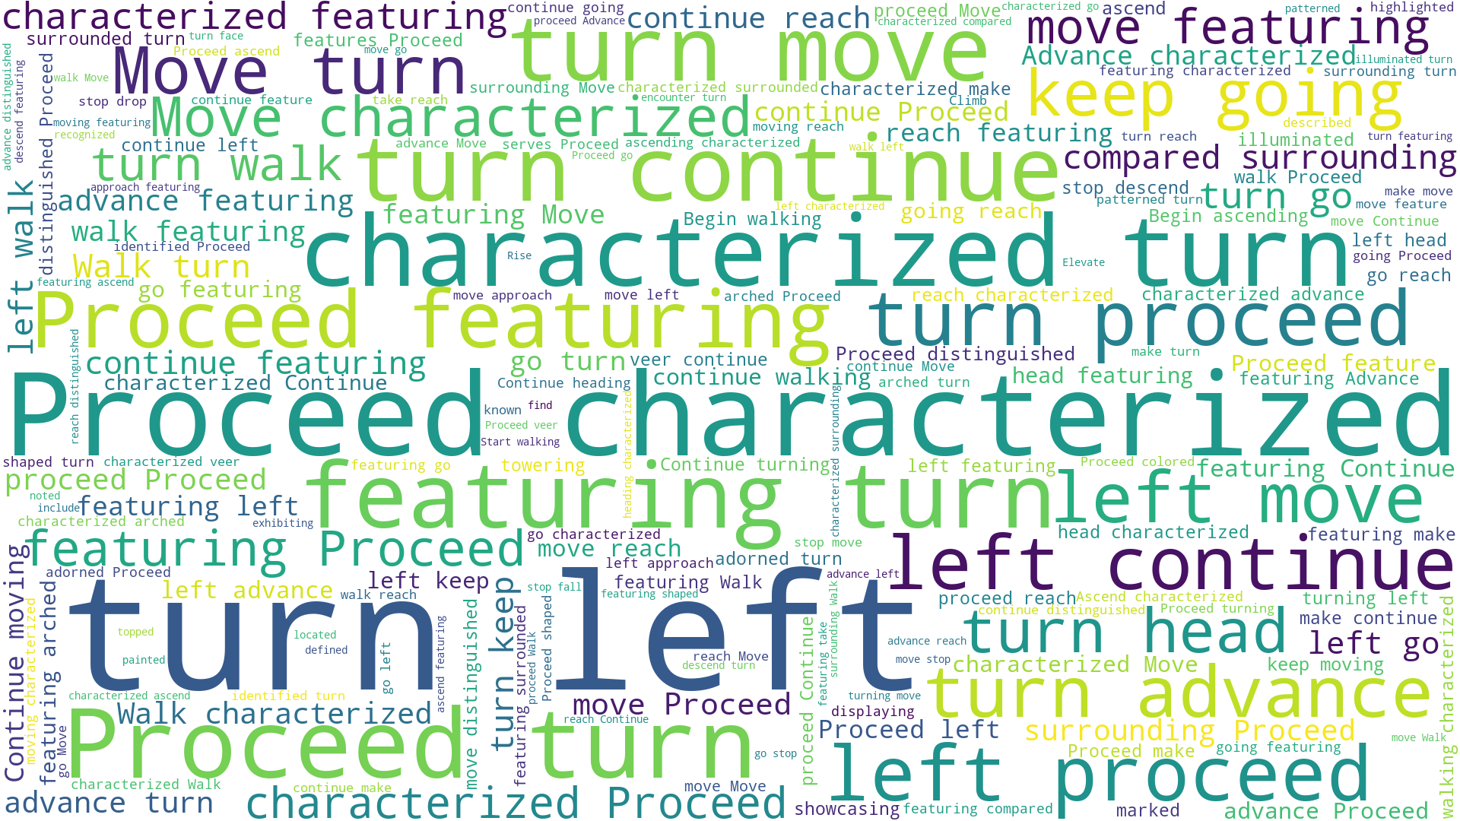
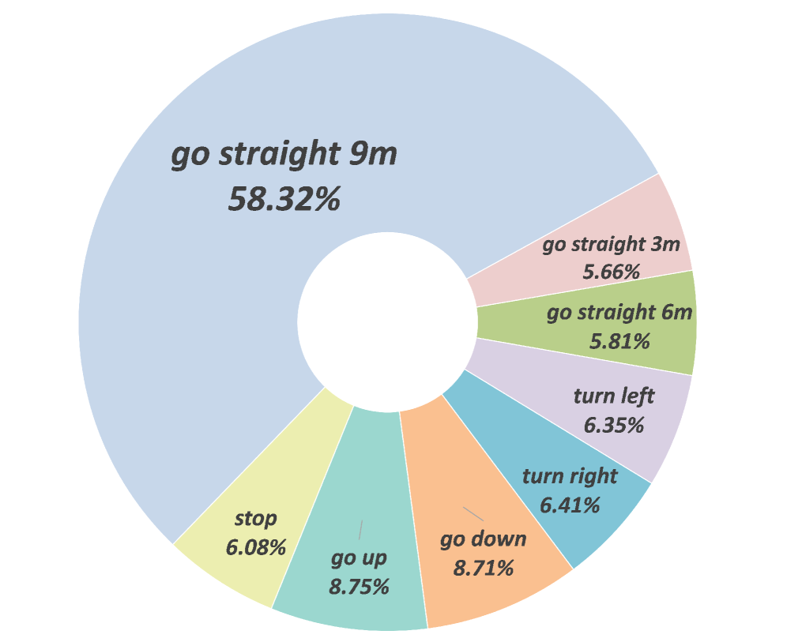
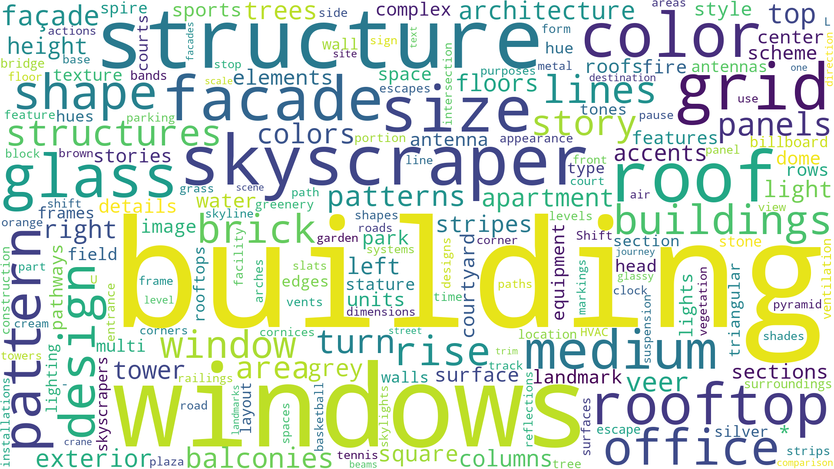
Statistical analysis of the generated data
Length and height distributions of trajectories.
Word cloud of verbs.
Action distributions.
Word cloud of nouns

Slide 11
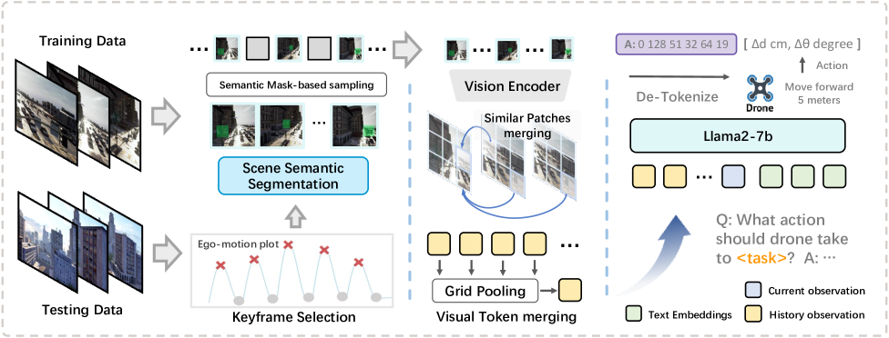
OpenFly Agent
A keyframe-aware VLN model for UAVs built on a Vision-Language-Action (VLA) backbone.
Inputs: image sequence (current frame + short visual history), natural-language instruction
Output: discrete UAV action at each step
Architecture (high level)
Vision encoder extracts visual tokens per frame
Language model (LLM) conditions on instruction + visual tokens
Action decoder maps tokens to UAV action space
Notes:
The OpenFly-Agent is a keyframe-aware Vision-Language-Action model designed for UAV navigation.

Slide 12
OpenFly Agent
Two core ideas
Keyframe Selection: keep frames around action transitions (where landmarks cue turns/ascents) → preserves the most informative observations
Visual Token Merging: merge similar tokens across adjacent keyframes → reduces redundancy & compute while keeping salient regions
Memory & compression
History buffer (small K) to retain latest keyframes
Grid pooling / token compression for past frames; current frame stays uncompressed for sharp perception
UAV action space
{Forward, Turn Left, Turn Right, Move Up, Move Down, Stop}
Forward uses multiple step sizes (e.g., 3/6/9 m); turns use fixed angles (e.g., 30°); up/down use fixed altitude steps (e.g., 3 m)
Notes:
It introduces two main innovations:
Keyframe Selection, which focuses the model on frames around action transitions. These are the most informative frames where landmarks matter.
Visual Token Merging and Memory Compression, which reduce redundancy across frames. Older frames are compressed, while the most recent frame remains fully detailed for precise decision-making.
The model then reasons over the instruction and these compact visual tokens using a vision encoder and language model, and outputs one of six discrete UAV actions—forward, turns, ascend, descend, or stop. Forward has multiple step sizes for flexibility.
This design ensures efficiency while retaining critical information, allowing OpenFly-Agent to outperform existing baselines

Slide 13
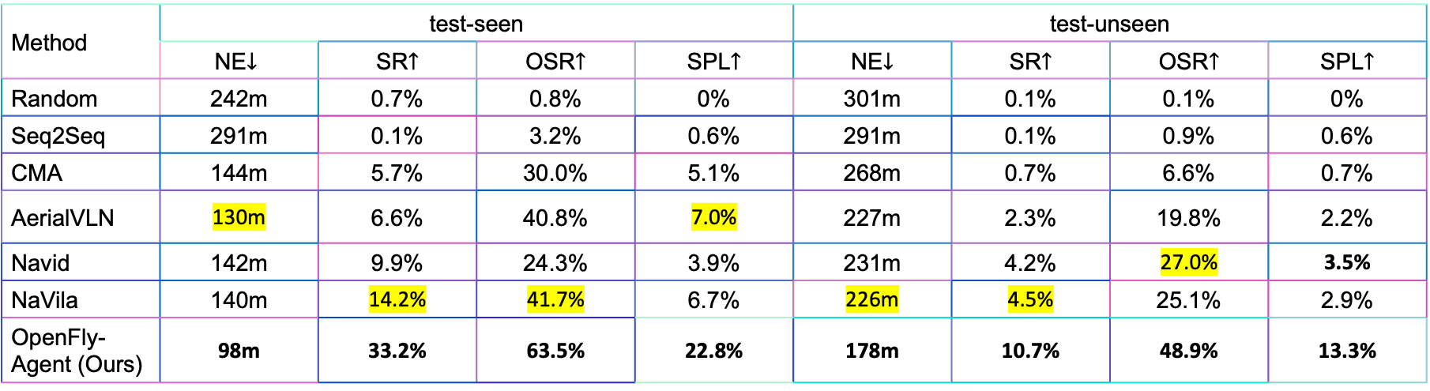
Results & Discussion
Evaluation Metrics
Navigation Error (NE) ↓
Success Rate (SR) ↑
Oracle Success Rate (OSR) ↑
Success weighted by Path Length (SPL) ↑
Method | test-seen |  |  |  | test-unseen
 | NE$↓$ | SR$↑$ | OSR$↑$ | SPL$↑$ | NE$↓$ | SR$↑$ | OSR$↑$ | SPL$↑$
Random | 242m | 0.7% | 0.8% | 0% | 301m | 0.1% | 0.1% | 0%
Seq2Seq | 291m | 0.1% | 3.2% | 0.6% | 291m | 0.1% | 0.9% | 0.6%
CMA | 144m | 5.7% | 30.0% | 5.1% | 268m | 0.7% | 6.6% | 0.7%
AerialVLN | 130m | 6.6% | 40.8% | 7.0% | 227m | 2.3% | 19.8% | 2.2%
Navid | 142m | 9.9% | 24.3% | 3.9% | 231m | 4.2% | 27.0% | 3.5%
NaVila | 140m | 14.2% | 41.7% | 6.7% | 226m | 4.5% | 25.1% | 2.9%
OpenFly-Agent (Ours) | 98m | 33.2% | 63.5% | 22.8% | 178m | 10.7% | 48.9% | 13.3%
Notes:
Experiments were evaluated using standard VLN metrics: Navigation Error, Success Rate, Oracle Success Rate, and SPL.
On seen environments, OpenFly-Agent achieved a success rate of 33.2%, compared to less than 15% for other models. On unseen environments, success dropped to 10.7%, but it still outperformed all baselines.

Slide 14
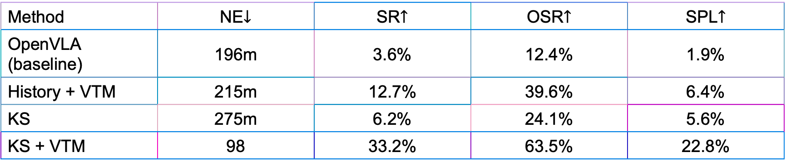
Result & Discussion
Benchmark Performance
OpenFly-Agent outperforms baselines (Seq2Seq, CMA, AerialVLN, Navid, NaVila)
Seen Environments: SR = 33.2% vs. <15% for others
Unseen Environments: SR = 10.7% (better generalization, still challenging)
Ablation Studies
Keyframe Selection + Token Merging = highest gains
Without these, performance drops significantly
Method | NE$↓$ | SR$↑$ | OSR$↑$ | SPL$↑$
OpenVLA (baseline) | 196m | 3.6% | 12.4% | 1.9%
History + VTM | 215m | 12.7% | 39.6% | 6.4%
KS | 275m | 6.2% | 24.1% | 5.6%
KS + VTM | 98 | 33.2% | 63.5% | 22.8%
Notes:
Ablation studies confirmed that keyframe selection and token merging are critical, as removing them significantly reduces accuracy.

Slide 15
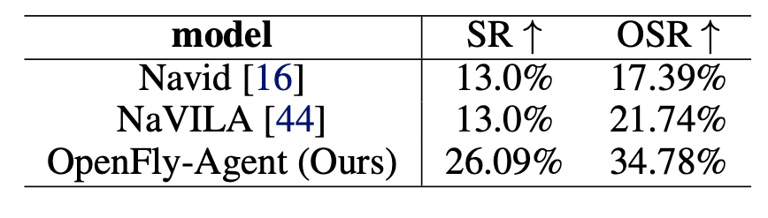
Results & Discussion
Real-World UAV Tests
Success Rate = 26.1%, OSR = 34.8%
Strong evidence of sim-to-real transfer
Notes:
Finally, in real-world UAV tests, OpenFly-Agent reached a success rate of 26.1%, demonstrating strong sim-to-real transfer. These results validate both the dataset and the model design

Slide 16
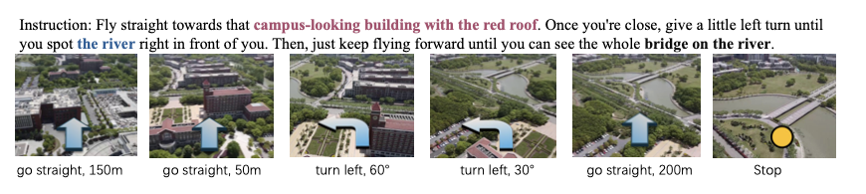
Illustrations of real-world experiments

Slide 17
Limitations
3D Gaussian Splatting
Large-scale reconstructions sometimes produce visual artifacts
Impacts realism in aerial environments
Model Practicality
OpenFly-Agent built on large VLMs (e.g., Llama2-7B)
High computational cost → not suitable for real-time UAV deployment
Generalization Challenge
Noticeable performance gap in unseen environments
Highlights the difficulty of adapting to novel aerial scenes
Notes:
Despite its strengths, OpenFly has some limitations

Slide 18
Future Work
Improved Scene Realism
Enhance 3D Gaussian Splatting for large-scale, artifact-free reconstruction
Lightweight & Efficient Models
Develop smaller VLM architectures for real-time UAV deployment
Explore quantization, pruning, and distillation techniques
Better Generalization
Improve performance on unseen environments
Leverage domain adaptation and sim-to-real transfer strategies
Expanded Applications
Extend OpenFly to multi-agent UAV tasks (e.g., cooperative search)
Integrate with real-world UAV platforms for practical deployment

Slide 19
Summary
While OpenFly makes important contributions, there are some limitations. First, although 3D Gaussian Splatting improves realism, in very large-scale reconstructions it still produces artifacts, which can affect navigation quality.
Second, the proposed OpenFly-Agent is built on large vision-language models. This design achieves strong accuracy but comes with a high computational cost, making it impractical for real-time UAV deployment without optimization.
Finally, the results show a significant performance drop in unseen environments, which highlights the ongoing challenge of generalization in aerial VLN. Addressing this gap will be crucial for real-world adoption.

Slide 20
Take Away
OpenFly fills the gap in aerial VLN with the largest, most diverse benchmark
Automated toolchain makes data collection scalable and efficient
OpenFly-Agent shows how keyframe awareness + token merging improve UAV navigation
Strong sim-to-real transfer → step toward practical UAV applications
Establishes a foundation for future research in aerial embodied AI

Slide 21
Thank You!
Questions.?

